Slide 1
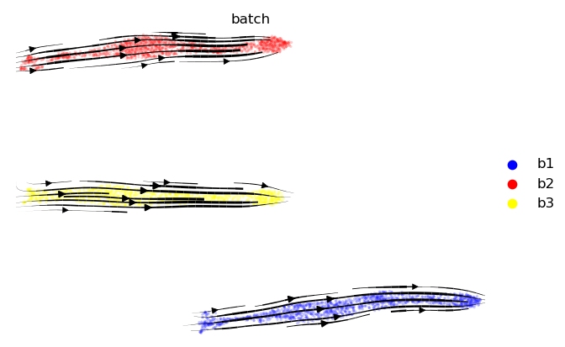
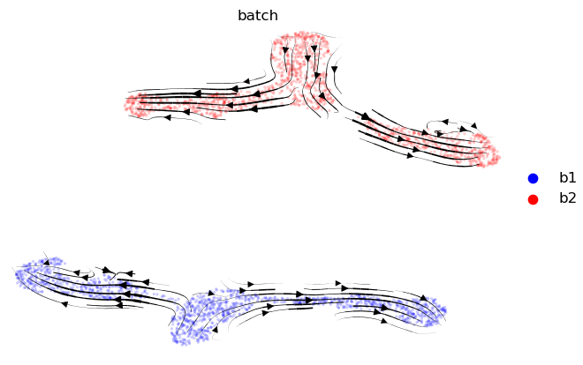
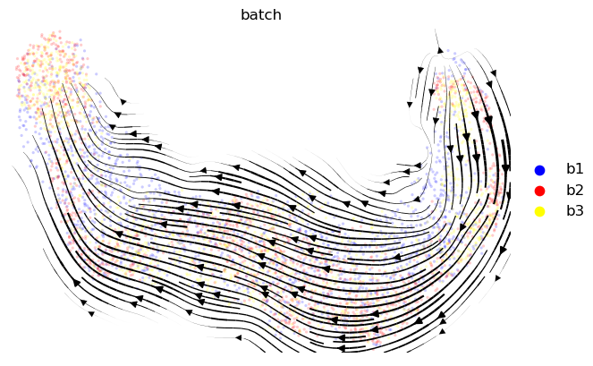
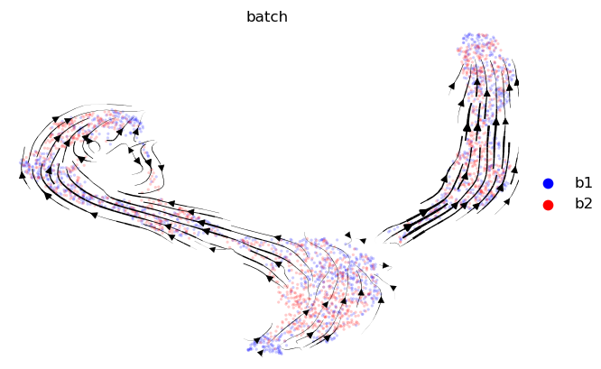

Slide 2
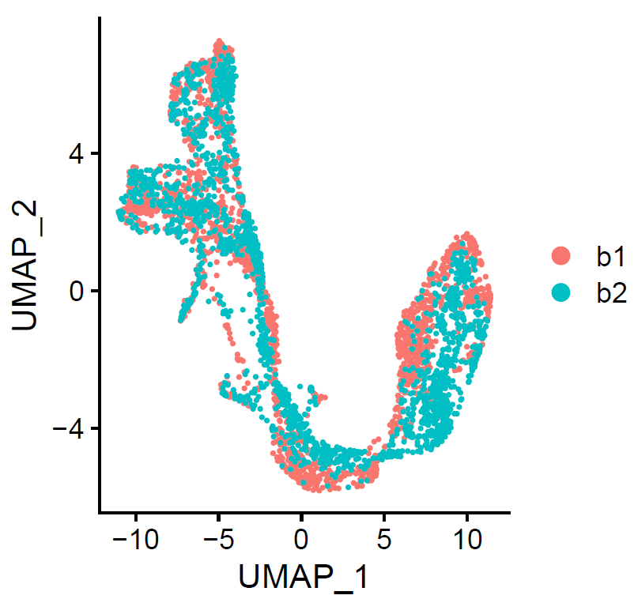
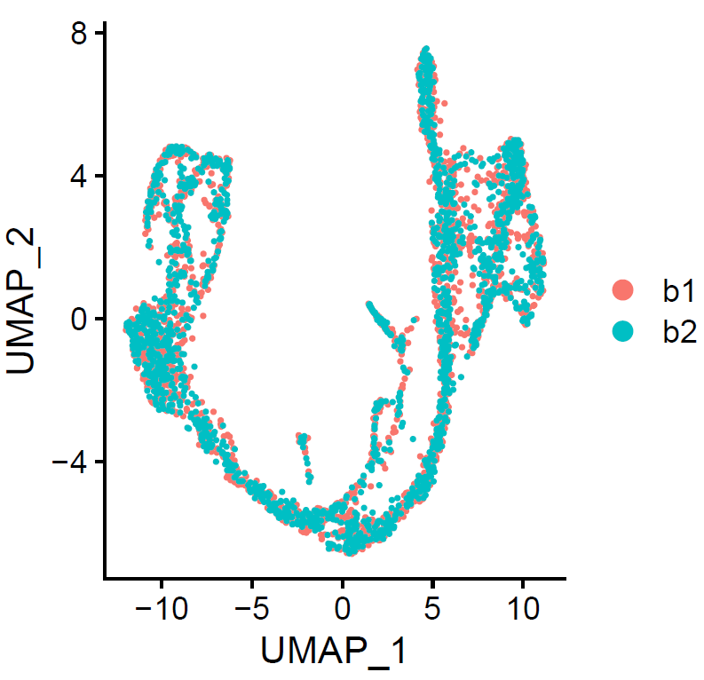
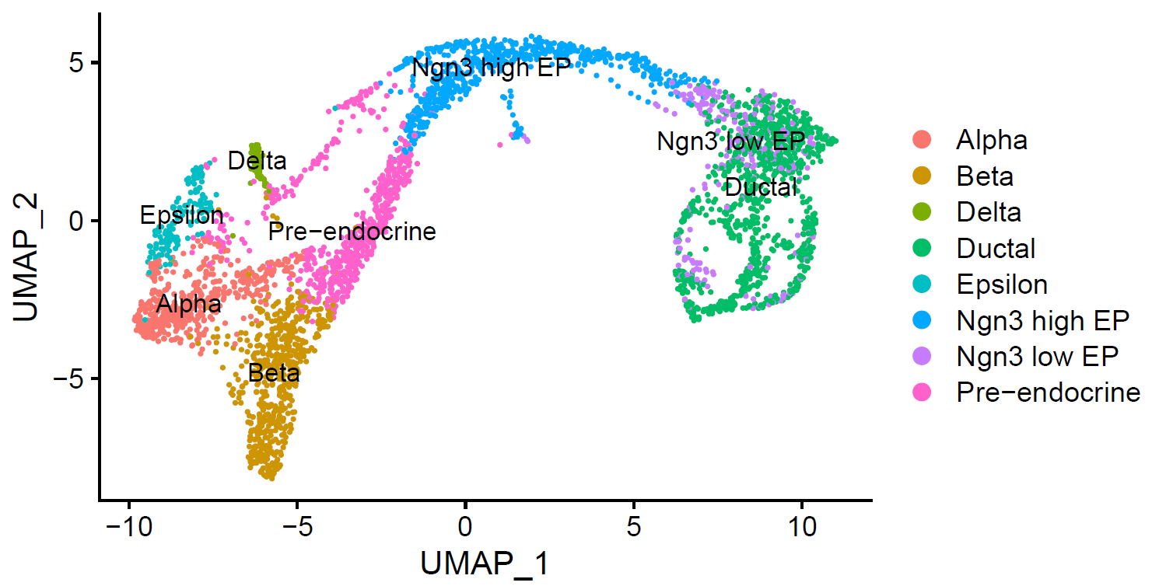
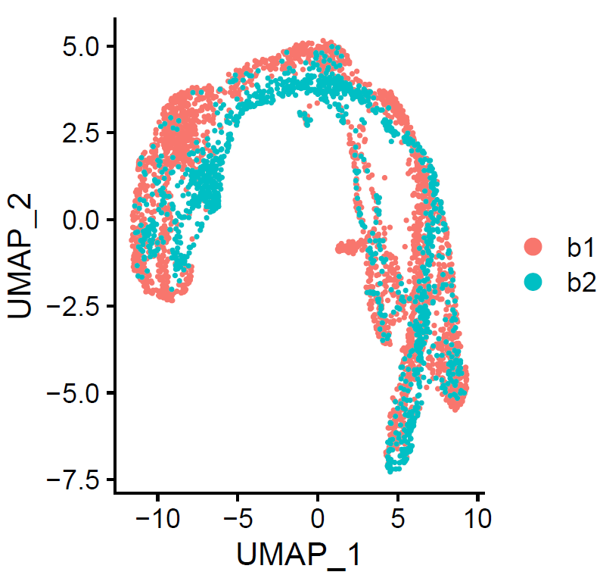
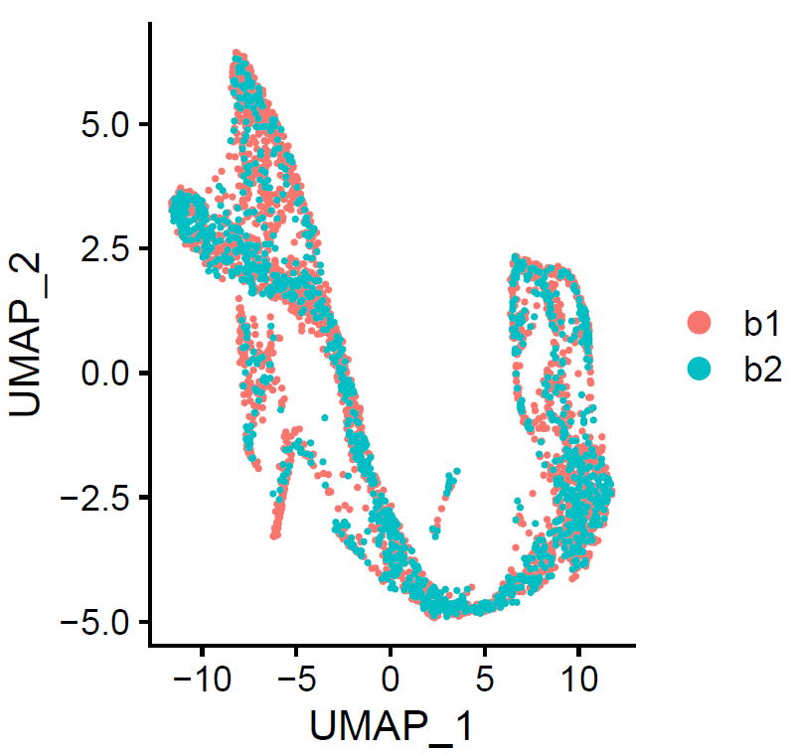
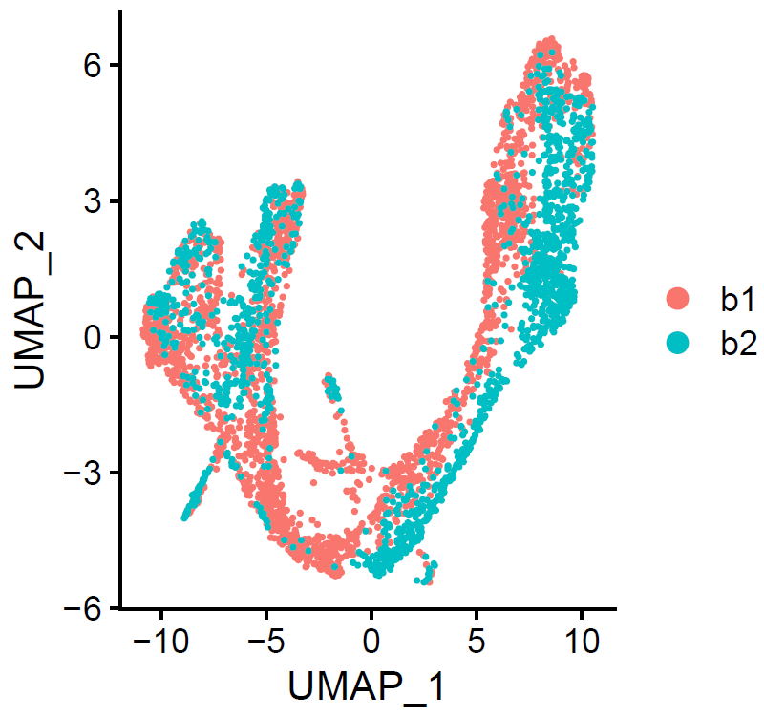
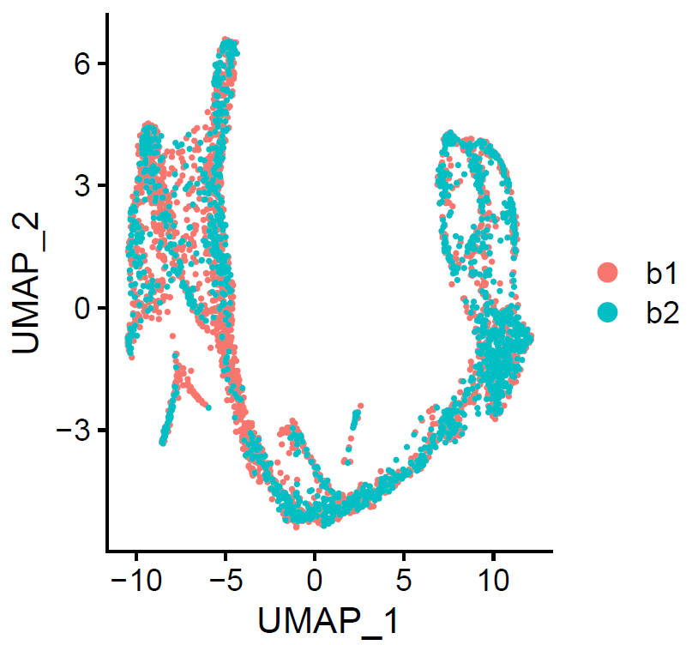
Experiment 1
Control
Experiment 2
Experiment 3

Slide 3
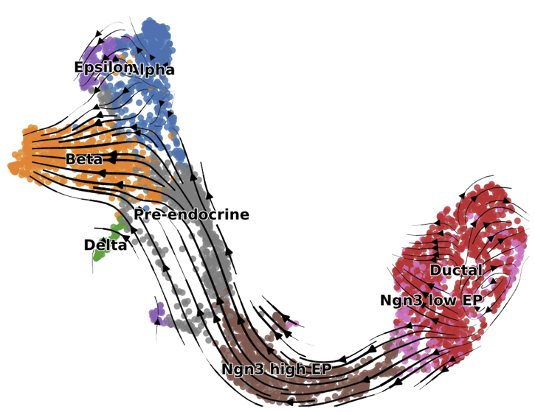
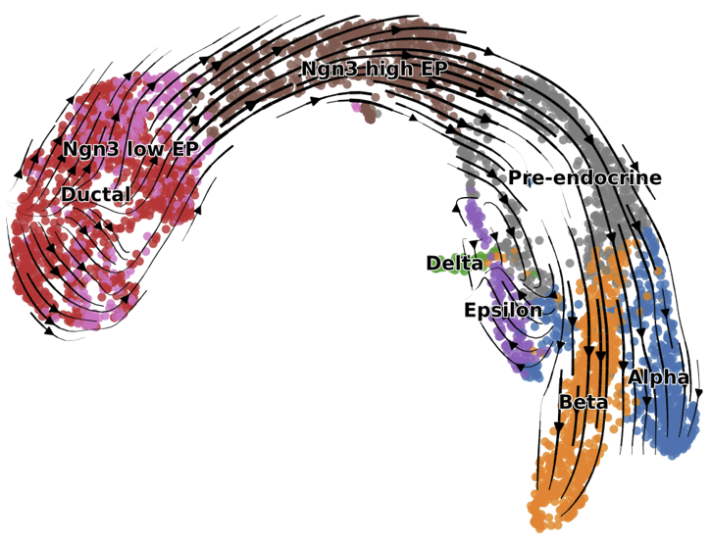
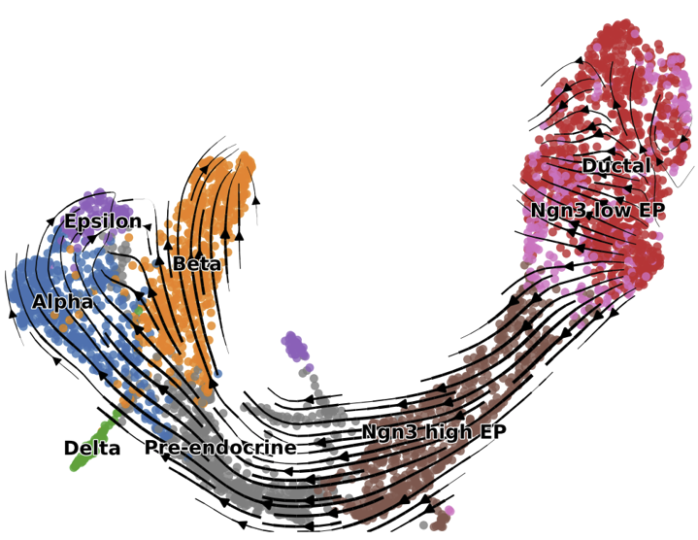
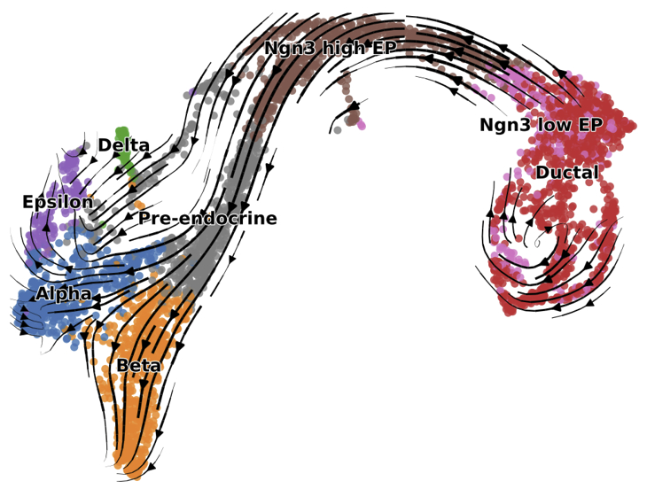
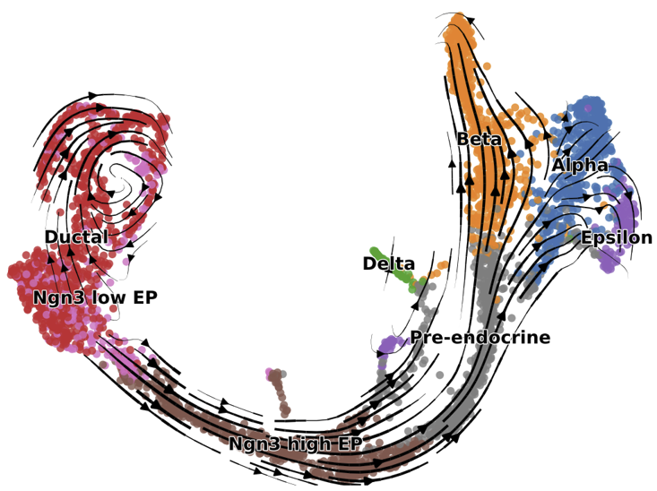
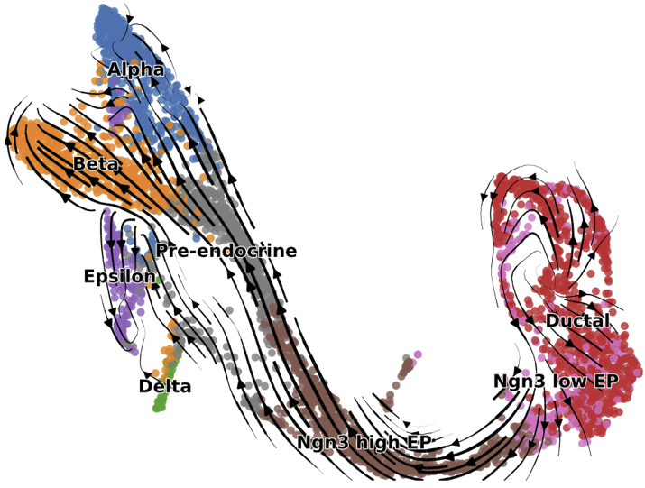
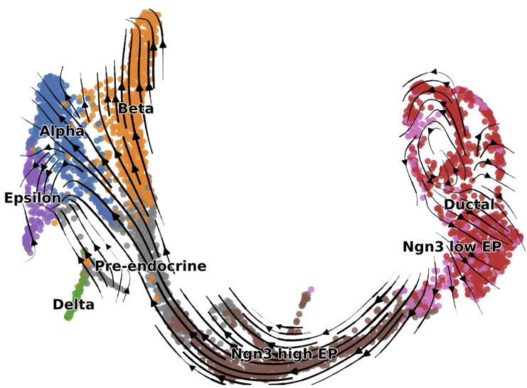
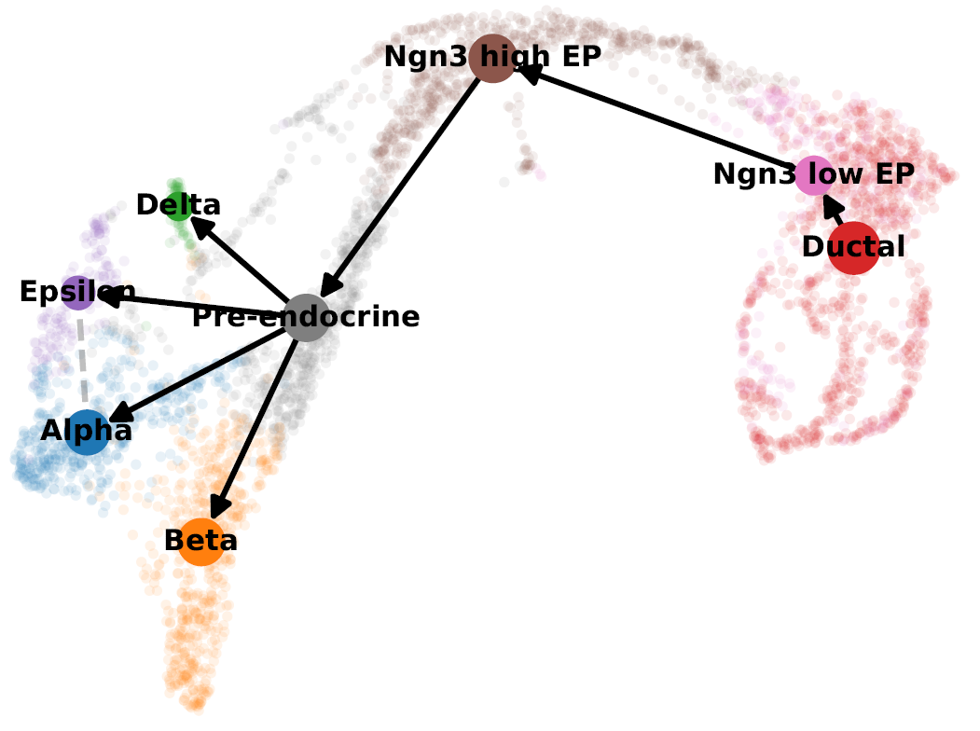
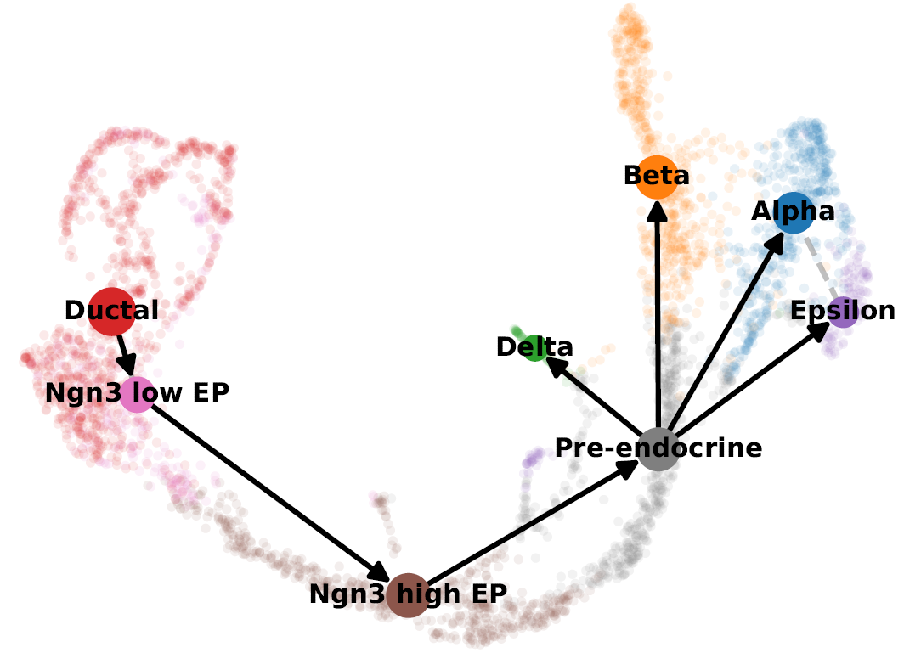
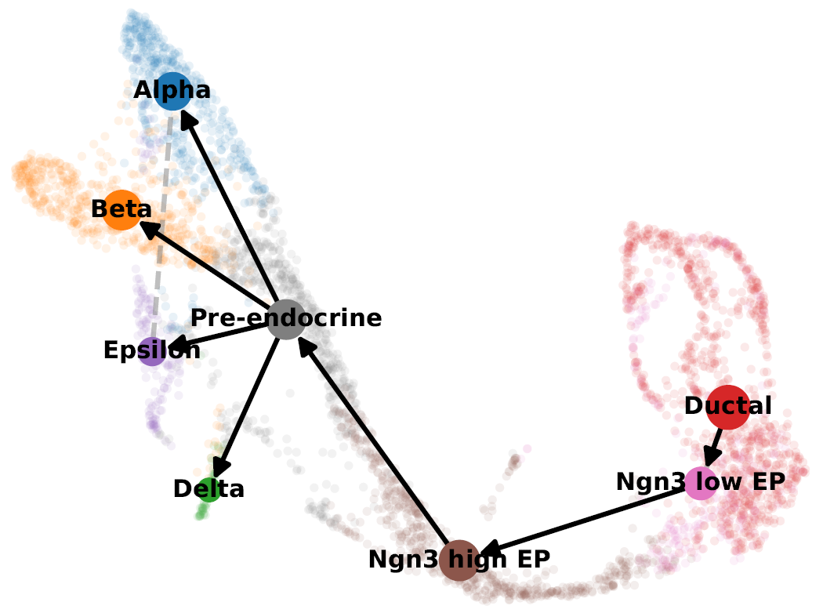
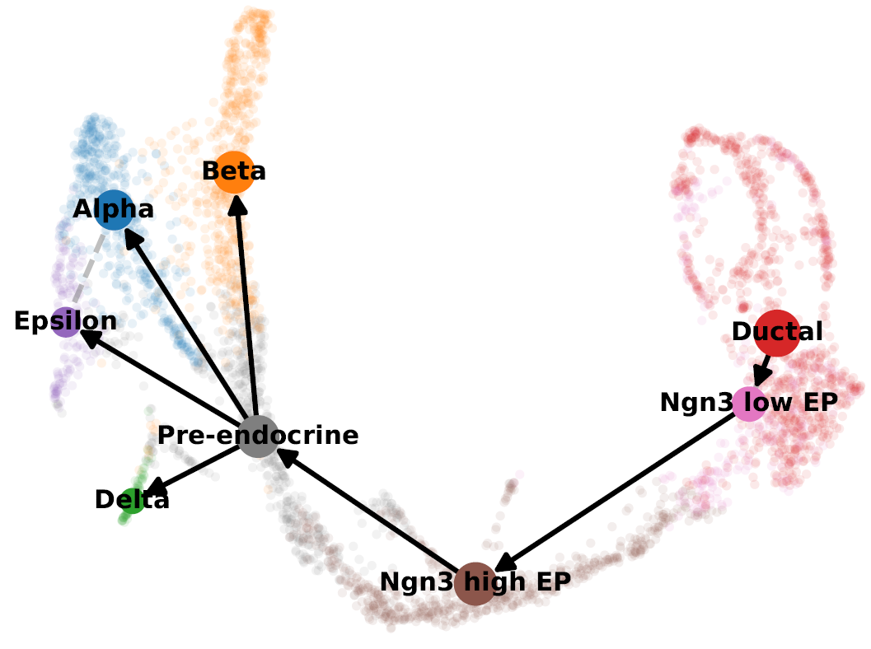
Experiment 1
Experiment 2
Experiment 3
Ductal: 0.89 Alpha: 0.83
Ngn3 low EP: 0.8 2 Beta: 0.95
Ngn3 high EP: 0.91 Delta: 0.95
Pre-endocrine: 0.97 Epsilon: 0.80
Ductal: 0.84 Alpha: 0.85
Ngn3 low EP: 0.73 Beta: 0.95
Ngn3 high EP: 0.92 Delta: 1
Pre-endocrine: 0.98 Epsilon: 0.93
Ductal: 0.86 Alpha: 0.86
Ngn3 low EP: 0.74 Beta: 0.94
Ngn3 high EP: 0.96 Delta: 0.98
Pre-endocrine: 0.97 Epsilon: 0.80
Control

Slide 4
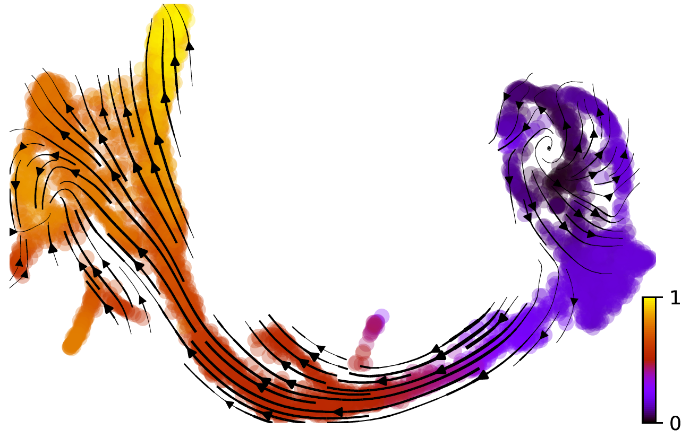
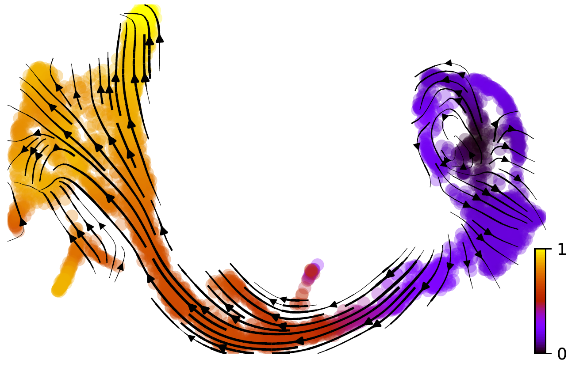
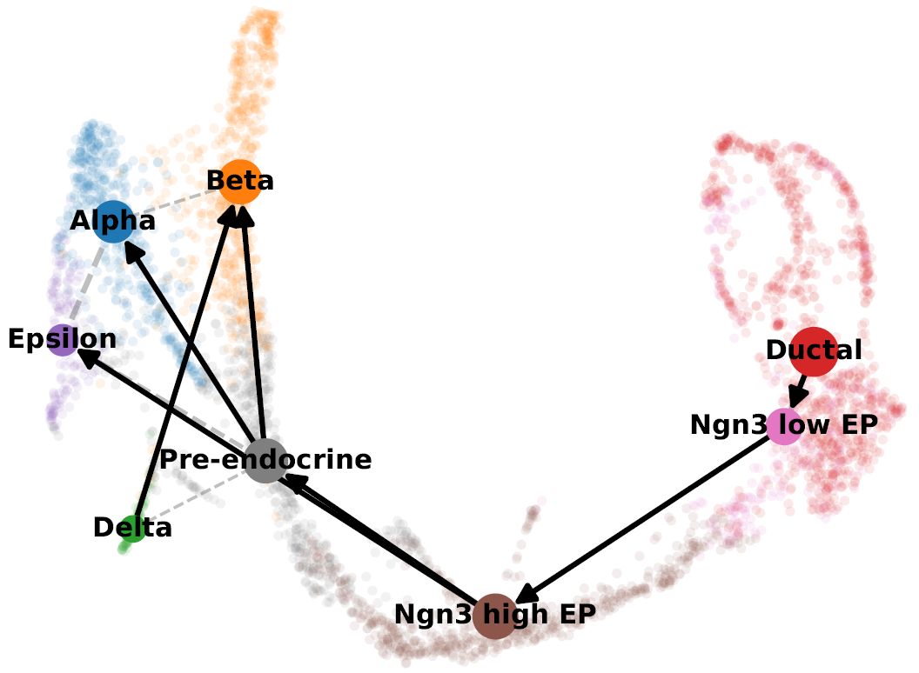
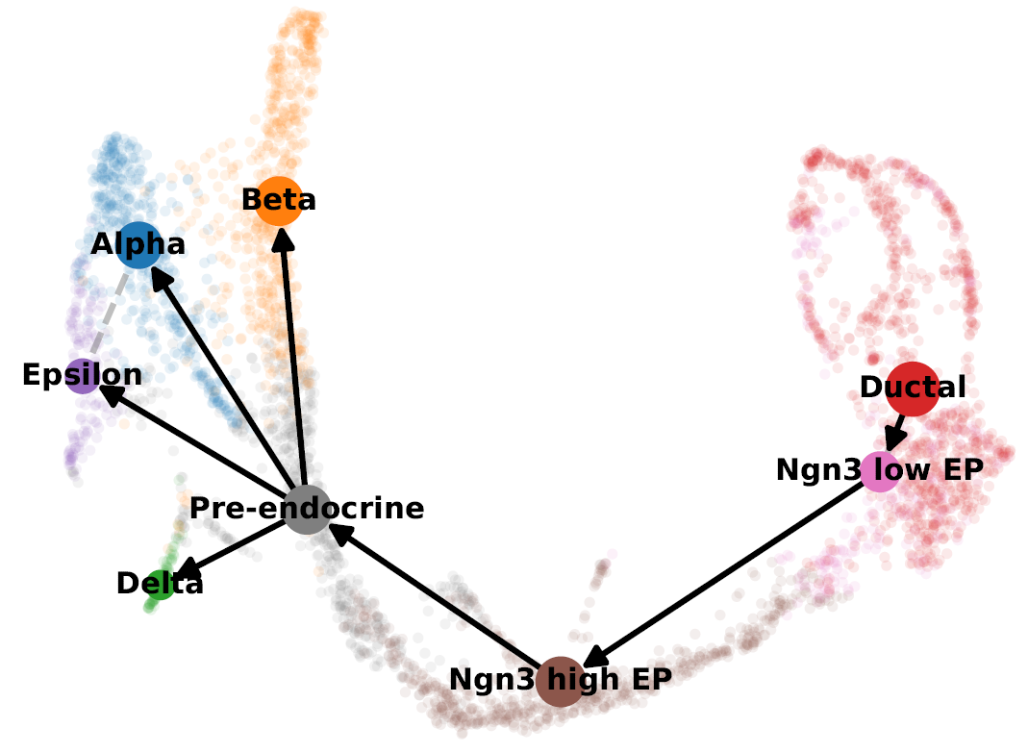
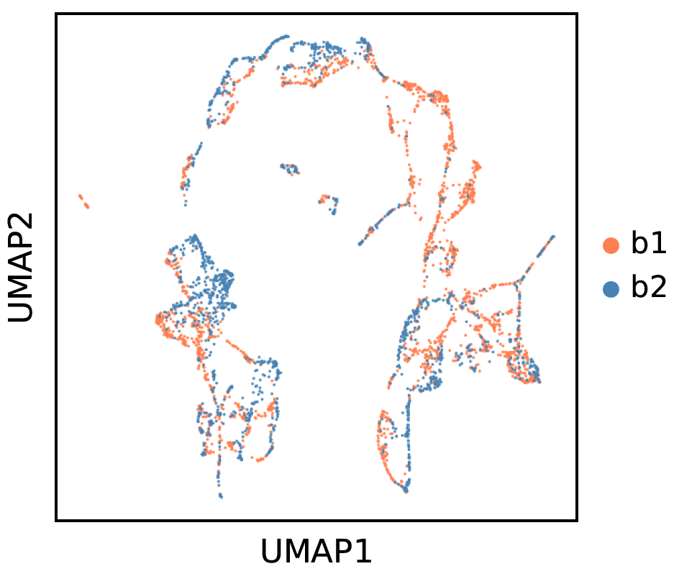
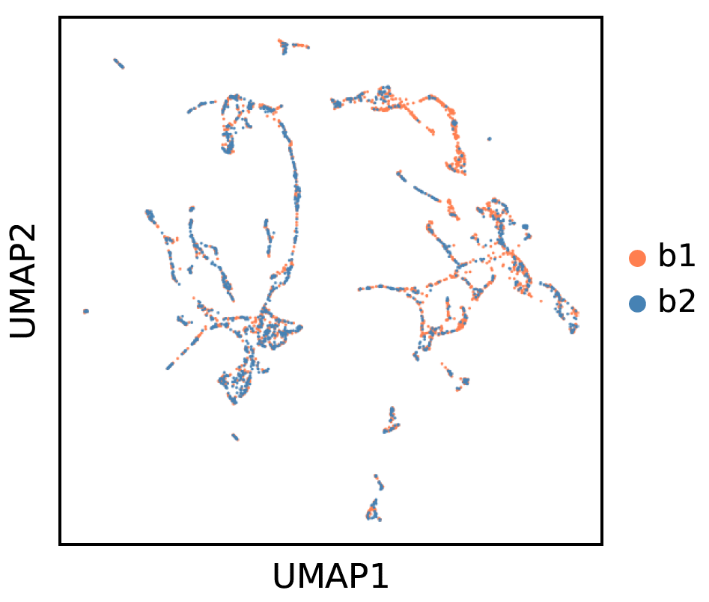
Pipeline 1
Pipeline 2
Mean cosine similarity
Mean cosine similarity
Ductal: 0.86 Alpha: 0.79
Ngn3 low EP: 0.75 Beta: 0.92
Ngn3 high EP: 0.87 Delta: 1
Pre-endocrine: 0.95 Epsilon: 0.80
Ductal: 0.86 Alpha: 0.86
Ngn3 low EP: 0.74 Beta: 0.94
Ngn3 high EP: 0.96 Delta: 0.98
Pre-endocrine: 0.97 Epsilon: 0.80

